Slide 1
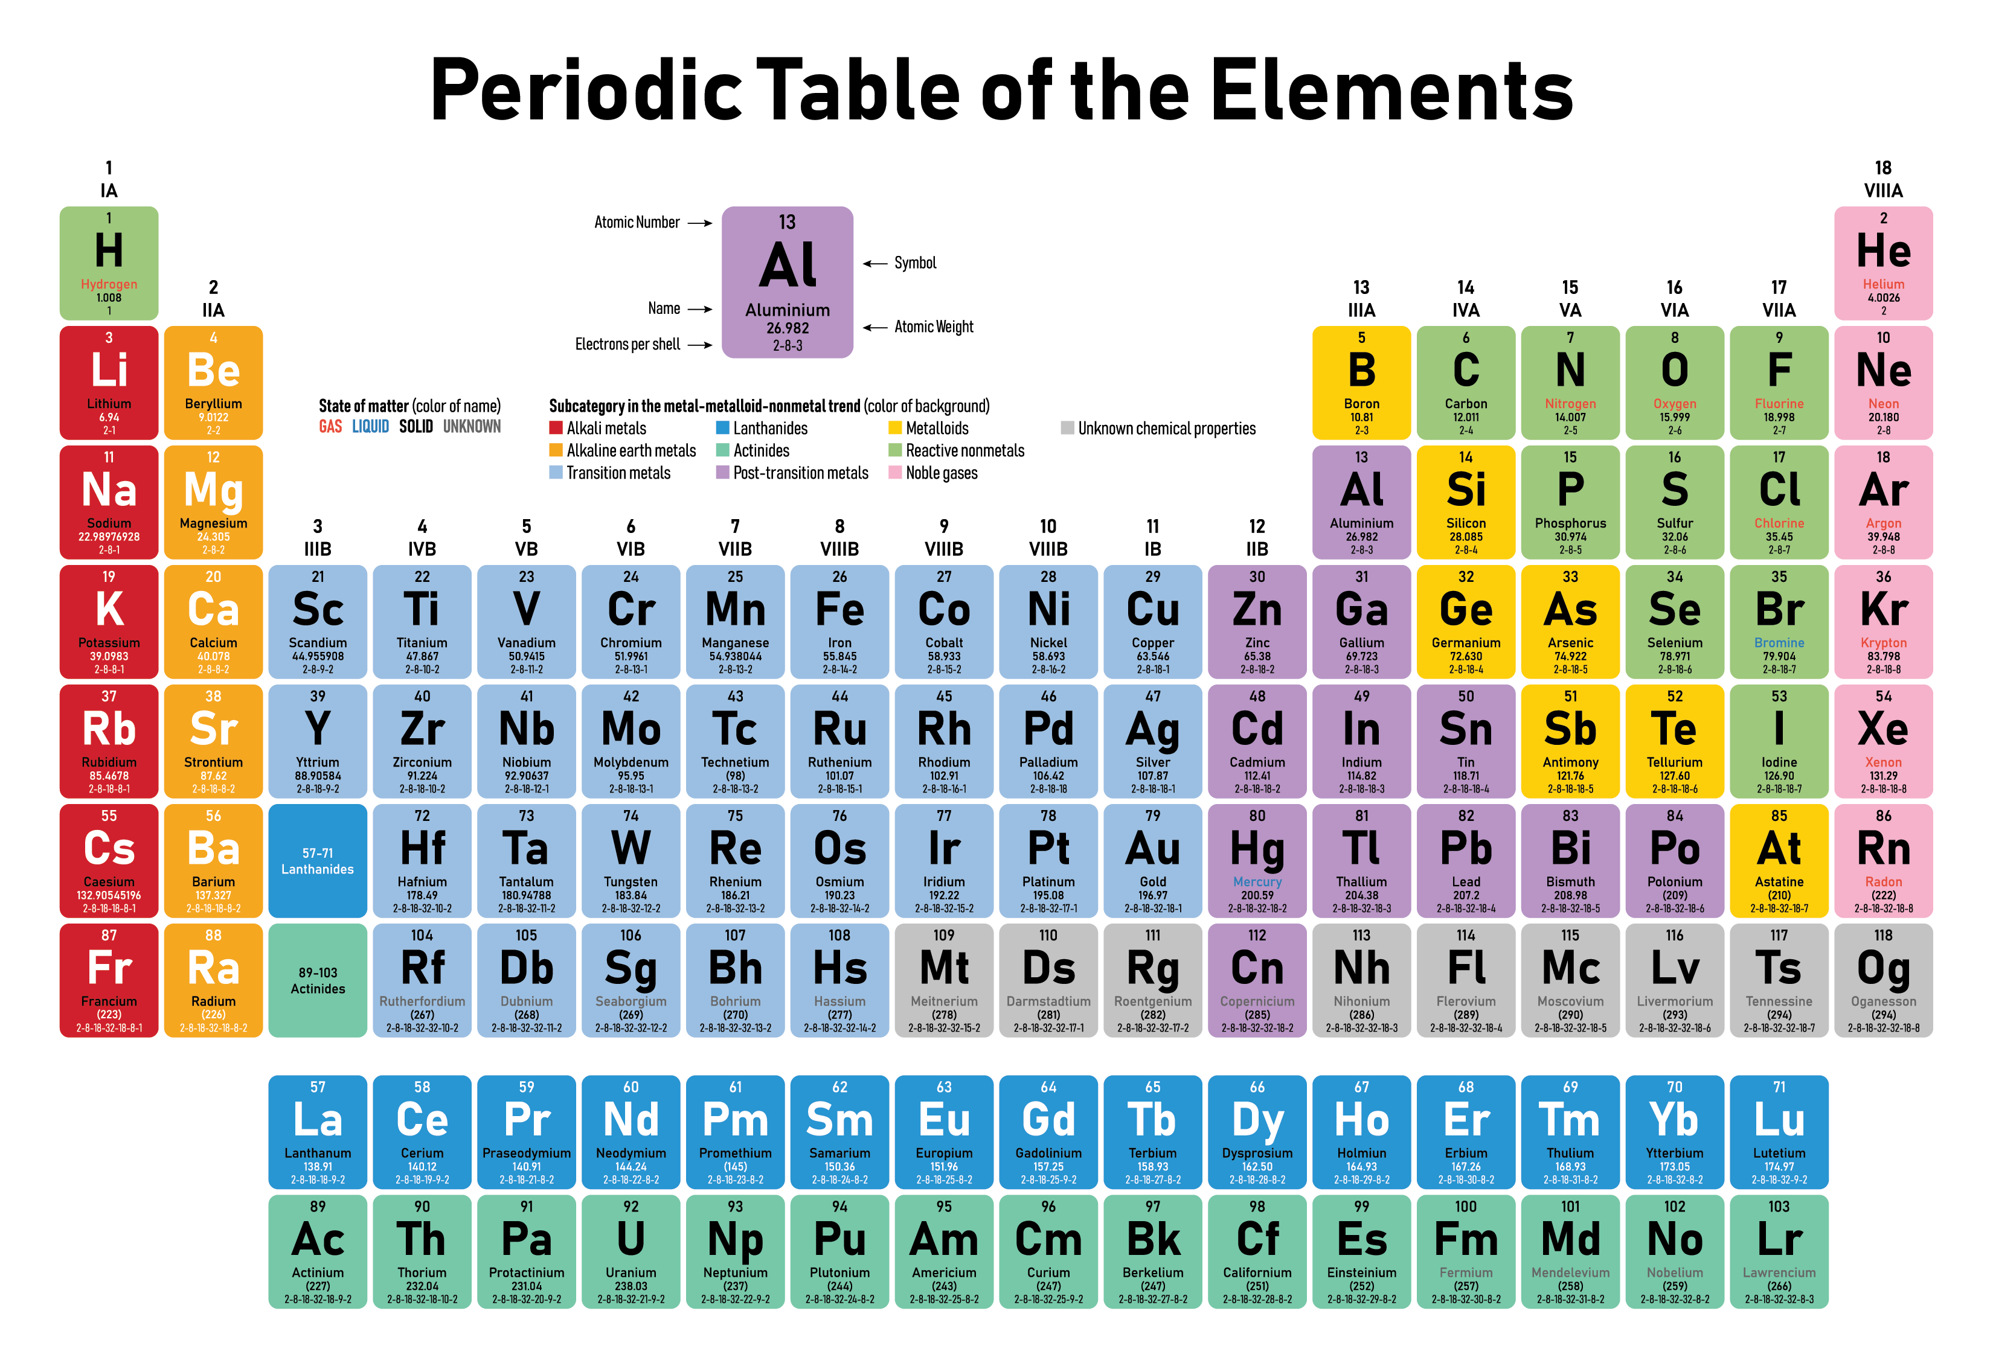

Slide 2
Can you define
Periodic?
Trend?
Electronegativity?
1st Ionization Energy?
Atomic Radius?
Picometer?
Can you define
Atomic Mass?
Group?
Period? Net Nuclear Charge?
Allotrope?
Metallic vs. Nonmetallic Properties?

Slide 3
Can you define
Periodic? Happens at a regular interval.
Trend? Pattern, a repeating system that is predictable.
Electronegativity? Tendency to gain electrons in a bond.
1st Ionization Energy? Energy needed to create a mole of +1 cations from atoms
Atomic Radius? Distance from center of nucleus to valence orbital edge
Picometer? One trillionth of a meter (super duper tiny)

Slide 4
Can you define
Atomic Mass?
Group?
Period? Net Nuclear Charge?
Allotrope?
Metallic vs. Nonmetallic Properties?

Slide 5
Can you define
Atomic Mass? Sum of AMU of protons + neutrons in a nucleus.
Group? Column on the periodic table (up and down)
Period? Row on the periodic table (left and right) Net Nuclear Charge? Sum of charges in nucleus (+ and neutral = +)
Allotrope? Pure element bonded different with different properties
Metallic vs. Nonmetallic Properties? Too many to list here.

Slide 6
Metallic vs. Nonmetallic Properties? Plenty of room here!
Metallic: luster, malleable, ductile, conducts electricity well, conducts heat well, relatively high density, relatively low specific heat capacity constant, forms only into cations when bonding, etc.
Nonmetallic: dull, brittle, not ductile, does not conduct electricity or heat very well, relatively low density, relatively higher specific heat capacity constant, forms only into anions when bonding with metals, can bond without forming ions with other nonmetals (covalent bonds), etc.

Slide 7
State the Group Trend for atomic mass.
Why does this happen?
State the Period trend for atomic mass.
Why does this happen?

Slide 8
State the Group Trend for atomic mass.
The group trend for atomic mass is increasing.
Why does this happen?
Each successive atom has more protons and more neutrons, they have mass of 1 AMU each.
State the Period trend for atomic mass.
Why does this happen?

Slide 9
State the Group Trend for atomic mass.
The group trend for atomic mass is increasing.
Why does this happen?
Each successive atom has more protons and more neutrons, they have mass of 1 AMU each.
State the Period trend for atomic mass.
The period trend for atomic mass is increasing.
Why does this happen? Each box below the previous has many more protons and neutrons, each has mass of 1 AMU.

Slide 10
State the Group Trend for atomic radius.
Why does this happen?
State the Period trend for atomic radius.
Why does this happen?

Slide 11
State the Group Trend for atomic radius.
The group trend for atomic radius is increasing.
Why does this happen?
Each atom in the box below has one more orbital than the previous.
State the Period trend for atomic radius.
Why does this happen?

Slide 12
State the Group Trend for atomic radius.
The group trend for atomic radius is increasing.
Why does this happen?
Each atom in the box below has one more orbital than the previous.
State the Period trend for atomic radius.
The period trend for atomic radius is decreasing.
Why does this happen? Moving across the period we have more protons PER the same number of orbitals, there is a greater and greater inward pull towards the nucleus.

Slide 13
State the Group Trend for Electronegativity.
Why does this happen?
State the Period trend for Electronegativity.
Why does this happen?

Slide 14
State the Group Trend for Electronegativity.
The group trend for electronegativity is decreasing.
Why does this happen?
Each atom below does have more protons, but the size (distance from the nucleus) weakens the inward attraction when pulling electrons in.
State the Period trend for Electronegativity.
Why does this happen?

Slide 15
State the Group Trend for Electronegativity.
The group trend for electronegativity is decreasing.
Why does this happen?
Each atom below does have more protons, but the size (distance from the nucleus) weakens the inward attraction when pulling electrons in.
State the Period trend for Electronegativity. The period trend for electronegativity is increasing.
Why does this happen? Same as atomic radius, we have more protons PER the same number of orbitals, there is a greater and greater inward pull for electrons in a bond.

Slide 16
State the Group Trend for Net Nuclear Charge.
Why does this happen?
State the Period trend for Net Nuclear Charge.
Why does this happen?

Slide 17
State the Group Trend for Net Nuclear Charge.
The group trend for Net Nuclear Charge is increasing.
Why does this happen?
Each atom below has many more protons, which is the measure of the charges in an atom’s nucleus (with a + sign)
State the Period trend for Net Nuclear Charge.
Why does this happen?

Slide 18
State the Group Trend for Net Nuclear Charge.
The group trend for Net Nuclear Charge is increasing.
Why does this happen?
Each atom below has many more protons, which is the measure of the charges in an atom’s nucleus (with a + sign)
State the Period trend for Net Nuclear Charge. The period trend for Net Nuclear Charge is increasing.
Why does this happen? Each successive atom in the period has one more proton. The table is set up in order of increasing atomic number (the number of protons)

Slide 19
State the Group Trend for 1st Ionization Energy.
Why does this happen?
State the Period trend for 1st Ionization Energy.
Why does this happen?

Slide 20
State the Group Trend for 1st Ionization Energy.
The group trend for 1st Ionization Energy is decreasing.
Why does this happen?
Each atom below has many more protons, which pulls harder, but the distance the electrons are from the nucleus greatly reduces the inward pull, the electrons are easier to pull off
State the Period trend for 1st Ionization Energy.
Why does this happen?

Slide 21
State the Group Trend for 1st Ionization Energy.
The group trend for 1st Ionization Energy is decreasing.
Why does this happen?
Each atom below has many more protons, which pulls harder, but the distance the electrons are from the nucleus greatly reduces the inward pull, the electrons are easier to pull off
State the Period trend for 1st Ionization Energy. The period trend for 1st Ionization Energy is increasing.
Why does this happen? Each successive atom in the period has one more proton. There is a greater pull inward, holding the electrons tighter. More and more protons per same number of orbitals.

Slide 22
State the Group Trend for Cation Size.
Why does this happen?
State the Period trend for Cation Size.
Why does this happen?

Slide 23
State the Group Trend for Cation Size.
The group trend for Cation Size is increasing.
Why does this happen?
Cations are smaller than their atoms, but going down a group you still are adding orbitals. Li⁺¹ has one orbital, Na ⁺¹ has two, K ⁺¹ three, etc.
State the Period trend for Cation Size.
Why does this happen?

Slide 24
State the Group Trend for Cation Size.
The group trend for Cation Size is increasing.
Why does this happen?
Cations are smaller than their atoms, but going down a group you still are adding orbitals. Li⁺¹ has one orbital, Na ⁺¹ has two, K ⁺¹ three, etc.
State the Period trend for Cation Size. The period trend for Cation Size is decreasing.
Why does this happen? Each successive atom in the period has one more proton. They now pull on the same exact orbitals, with a greater and greater inward pull. More protons per same number of orbitals (here same exact configurations)

Slide 25
State the Group Trend for Anion Size.
Why does this happen?
State the Period trend for Anion Size.
Why does this happen?

Slide 26
State the Group Trend for Anion Size.
The group trend for anion size is increasing.
Why does this happen?
Going down the group, each atom adds another orbital, making atoms (here anions bigger).
State the Period trend for Anion Size.
Why does this happen?

Slide 27
State the Group Trend for Anion Size.
The group trend for anion size is increasing.
Why does this happen?
Going down the group, each atom adds another orbital, making atoms (here anions bigger).
State the Period trend for Anion Size. The period trend for anion size is decreasing.
Why does this happen? Same as with cations, more and more protons added, pulling on the same number of orbitals (here the exact same electron configurations. All anions in one period have the same isoelectric ionic configuration).

Slide 28
State the Group Trend for Anion Size.
The group trend for Anion Size is increasing.
Why does this happen?
Cations are smaller than their atoms, but going down a group you still are adding orbitals. Li⁺¹ has one orbital, Na ⁺¹ has two, K ⁺¹ three, etc.
State the Period trend for Anion Size. The period trend for Cation Size is decreasing.
Why does this happen? Each successive atom in the period has one more proton. They now pull on the same exact orbitals, with a greater and greater inward pull. More protons per same number of orbitals (here same exact configurations)

